Slide 1
WELCOME EVERYONE

Slide 2
UNIVERSITY MANAGEMENT SYSTEM (UMS)

Slide 3
HELLO!
WE ARE TEAM - 2
SECTION – 12 INTAKE - 44
IFTEKHAR AHAMED SIDDIQUEE
IFTEKHAR AHAMED SIDDIQUEE
SUPERVISOR
ID: 19202103239
Badhan Chandra Das
Lecturer Department Of Computer Science
And Engineering
MD. REDOAN
ID: 19202103475
MD. NAEEM
ID: 19202103472
MIHRAJ AL MUMAD
ID: 19202103448
3

Slide 4
Project Review
Background
Advantages
System Requirements
Project Model
Program Feature
Feature Details
Future work
Conclusion
4

Slide 5
INTRODUCTION
UNIVERSITY MANAGEMENT SYSTEM
Student Details.
Employee Details.
Teacher Details.
Notice.
Academic Related Reports.
Course Details.
Registration.
Communication.
Result
5

Slide 6
OBJECTIVE
To become a non-stop data center.
To reduce paper work.
To reduce work in mind.
Build a communication between teacher
and student.
Make secured data.
6

Slide 7
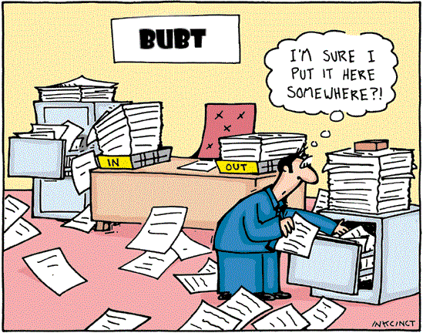
Problem Definition
10000+ Student
200+ Teacher
100+ Employee
5+ Department
7

Slide 8

ADVANTAGES
Less human error.
Fast search.
Strength and strain of registers and papers can be reduced.
High security.
Data consistency.
Easy to handle.
Easy data updating.
Easy record keeping.
Backup data .
Easy Registration .
Easy Communication.
8

Slide 9








System Requirements
HARDWARE REQUIREMENTS
(Minimum Requirement)
Minimum Ram : 1 GB OR MORE
Hard Disk : - 40 GB or more
Processor :-Intel Pentium 3 or above
SOFTWARE REQUIREMENTS
(Minimum Requirement)
.
.Windows 2000/2008/2010/NT/XP/Vista
Visual Studio
My Sql Database
Latex
GitHUB
9

Slide 10
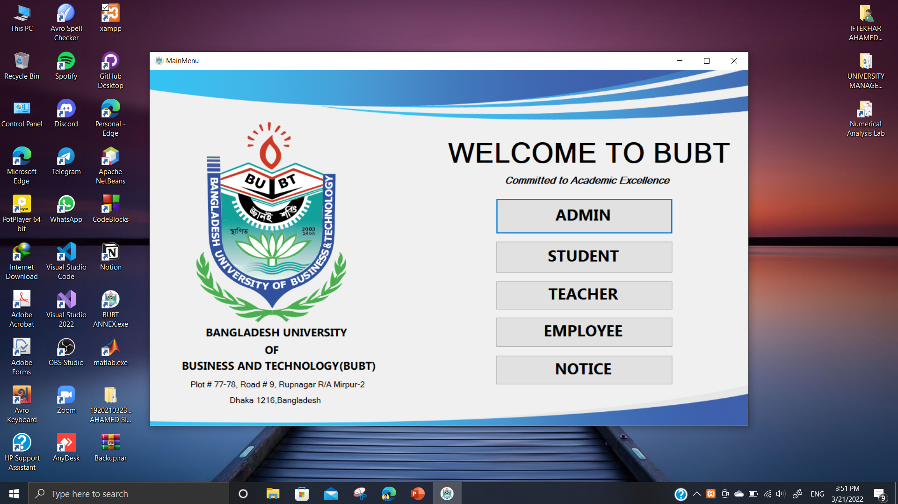
Program Feature
ADMIN
TEACHER
STUDENT
EMPLOYEE
NOTICE
10

Slide 11
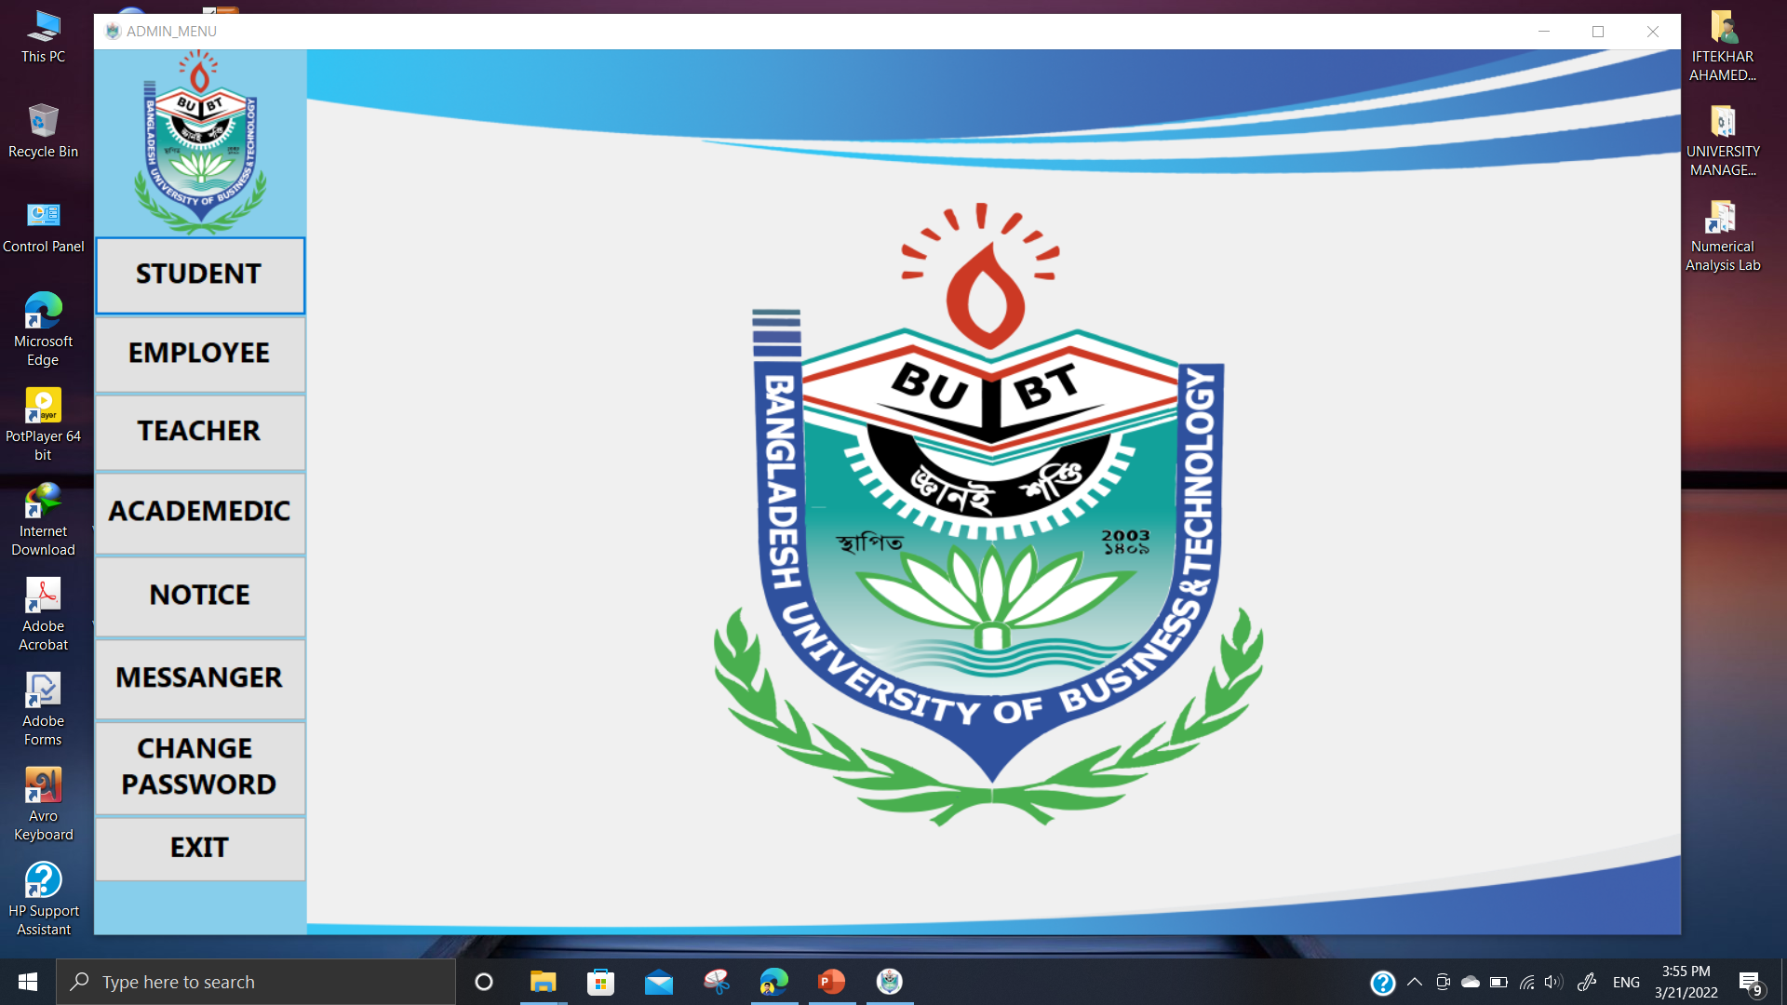
Feature Details
ADMIN
TEACHER
EMPLOYEE
STUDENT
ACADEMIC
NOTICE
MESSANGER
CHANGE PASSWO-
RD
11

Slide 12
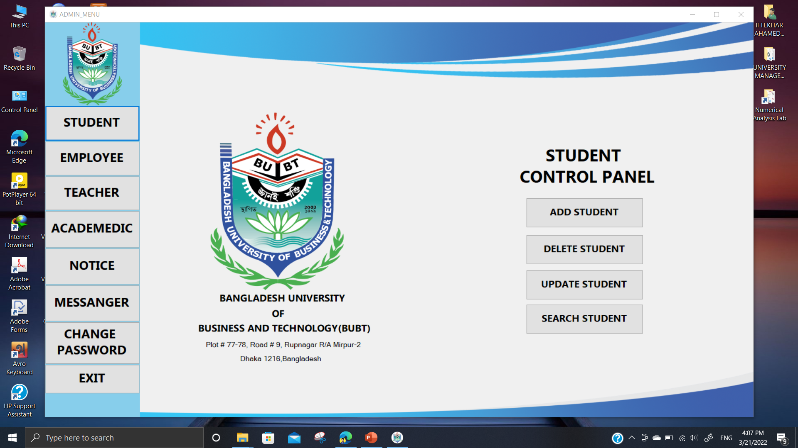
Feature Details
ADMIN-TEACHER-STUDENT-EMPLOYEE
ADD NEW
UPDATE EXISTING
DELETE EXISTING
SEARCH EXISTING
12

Slide 13
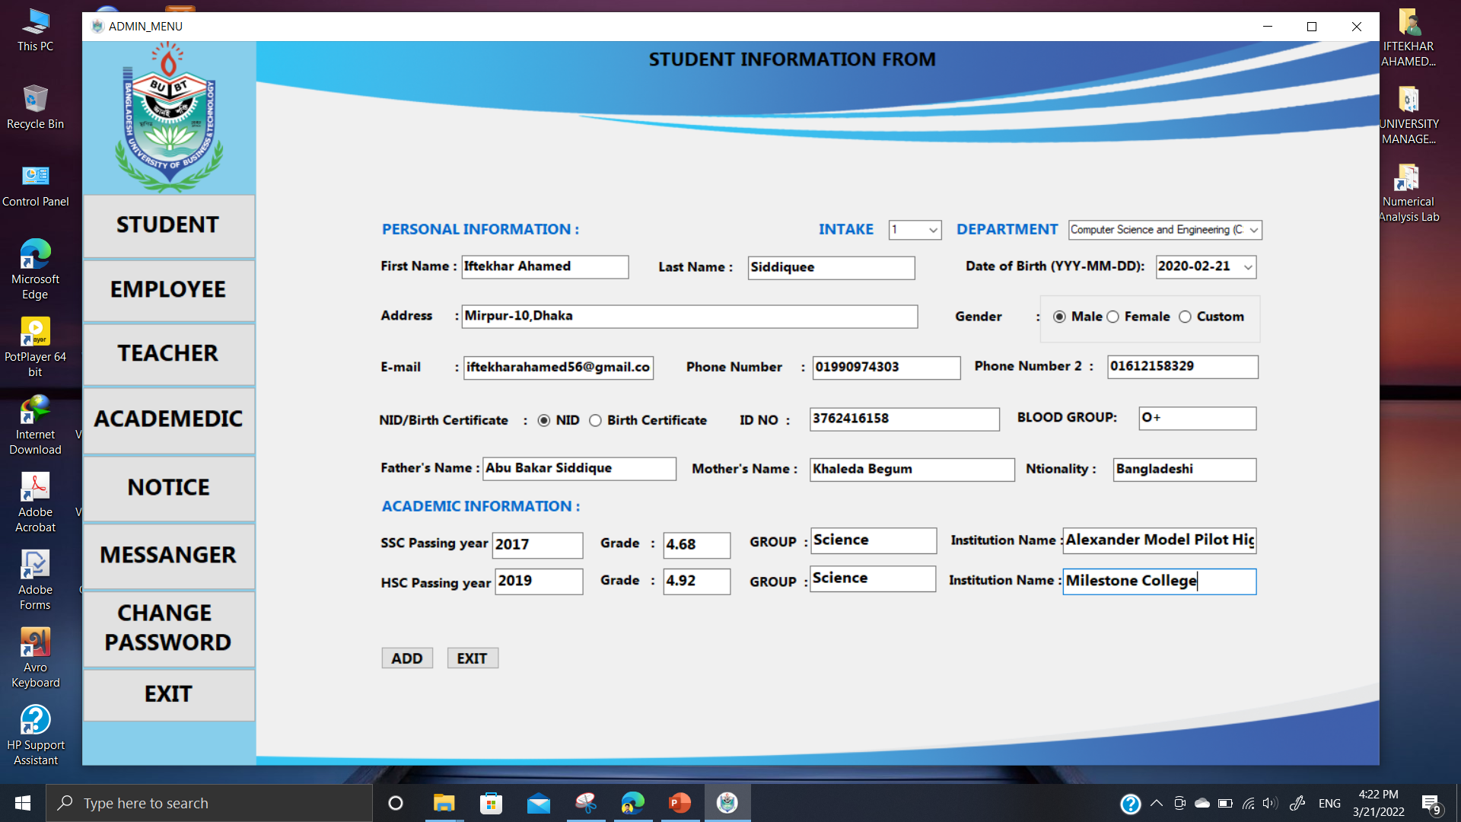
Feature Details
Add new teacher-employee-student
ADD NEW TEACHER-EM
-PLOYEE-STUDENT
13

Slide 14
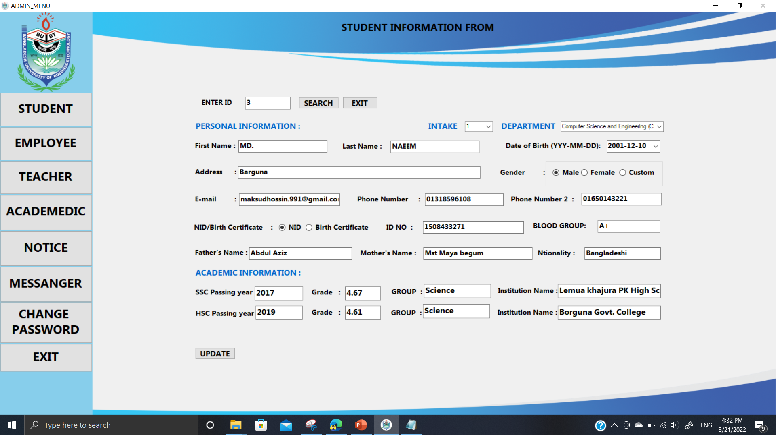
ADMIN-teacher-STUDENT-EMPLOYEE
update
UPDATE TEACHER-STU
DENT-EMPLOYEE INFO
14

Slide 15
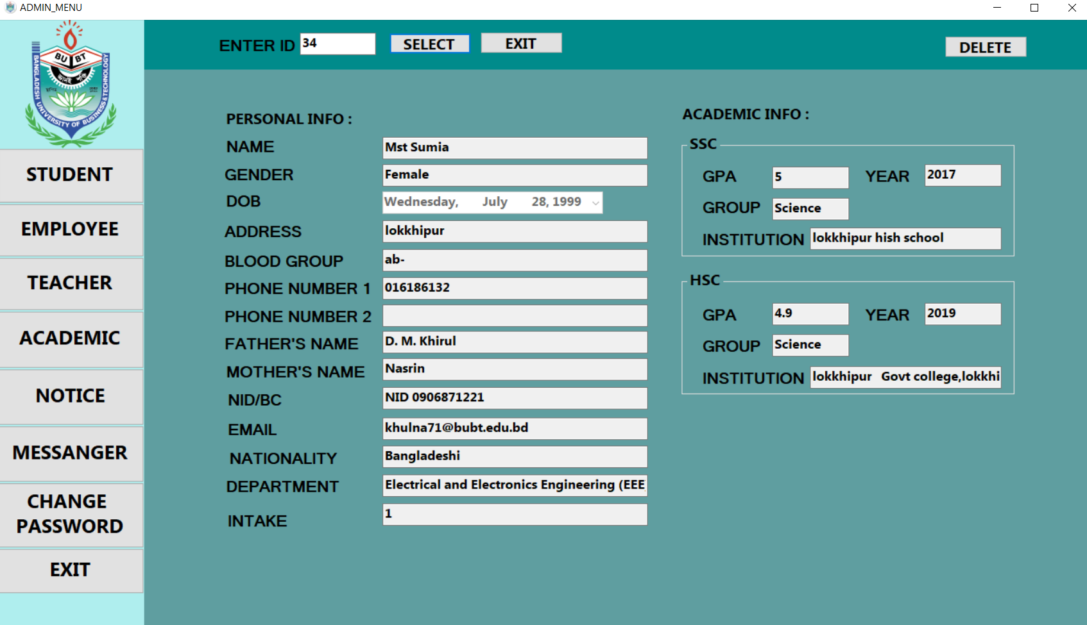
ADMIN-teacher-STUDENT-EMPLOYEE
DELETE
DELETE TEACHER-ST
UDENT-EMPLOYEE
ID
CONFIRMATION
DELETE
15

Slide 16
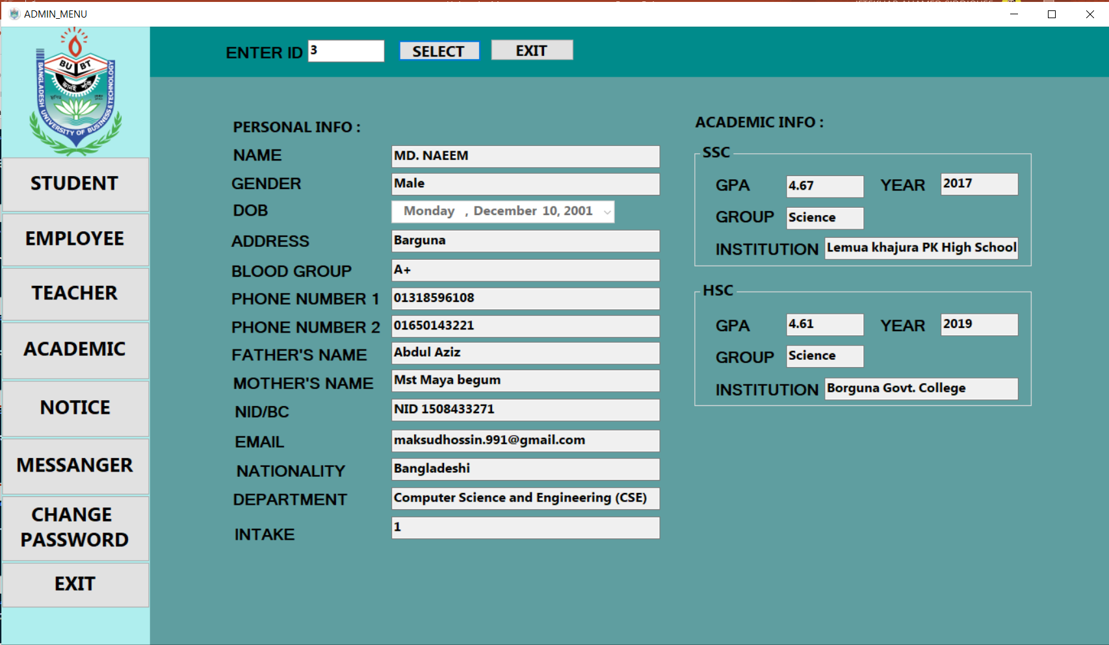
ADMIN-teacher-STUDENT-EMPLOYEE
SEARCH
SEARCH
ID
SEE DATA
16

Slide 17
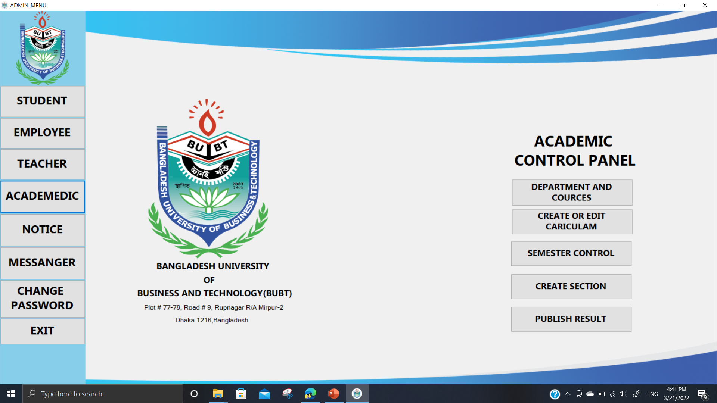
ADMIN-ACADEMIC
DEPARTMENT AND COURSE
CARICULAM EDIT-CREATE
SEMESTER CONTROL
SECTION CREATE
RESULT PUBLISH
17

Slide 18
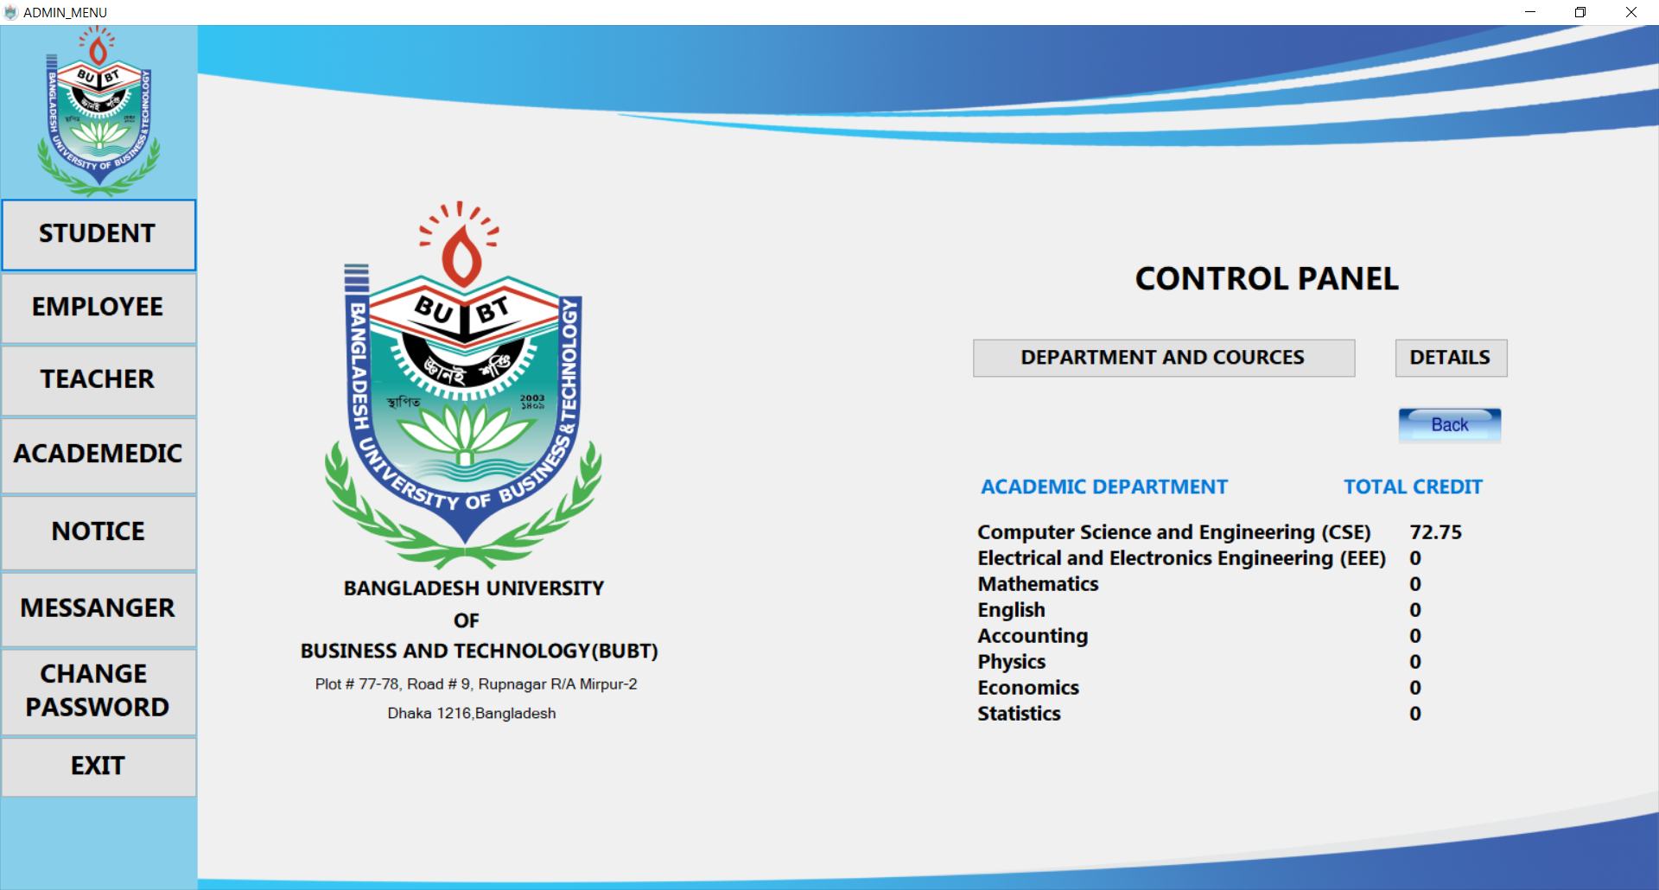
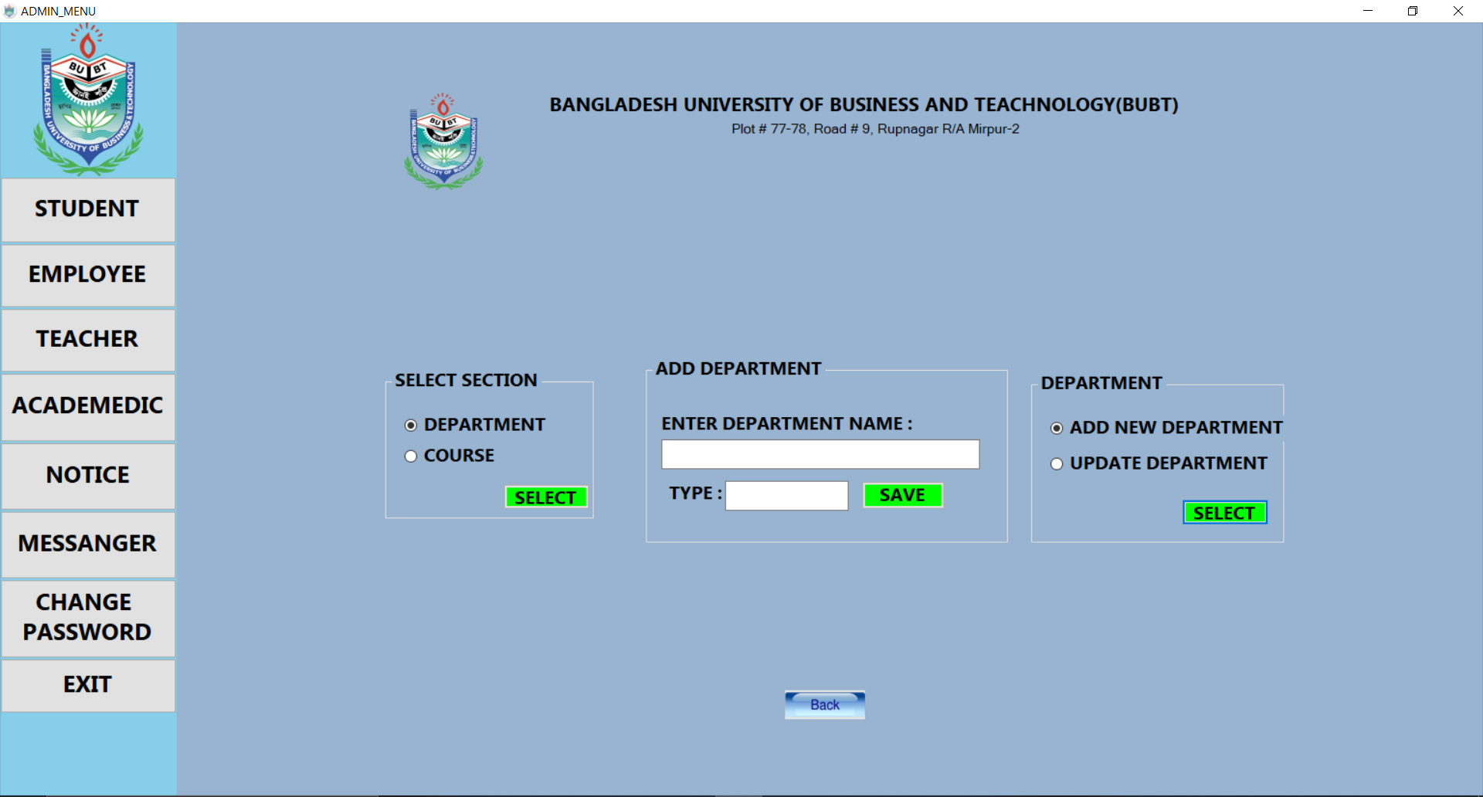
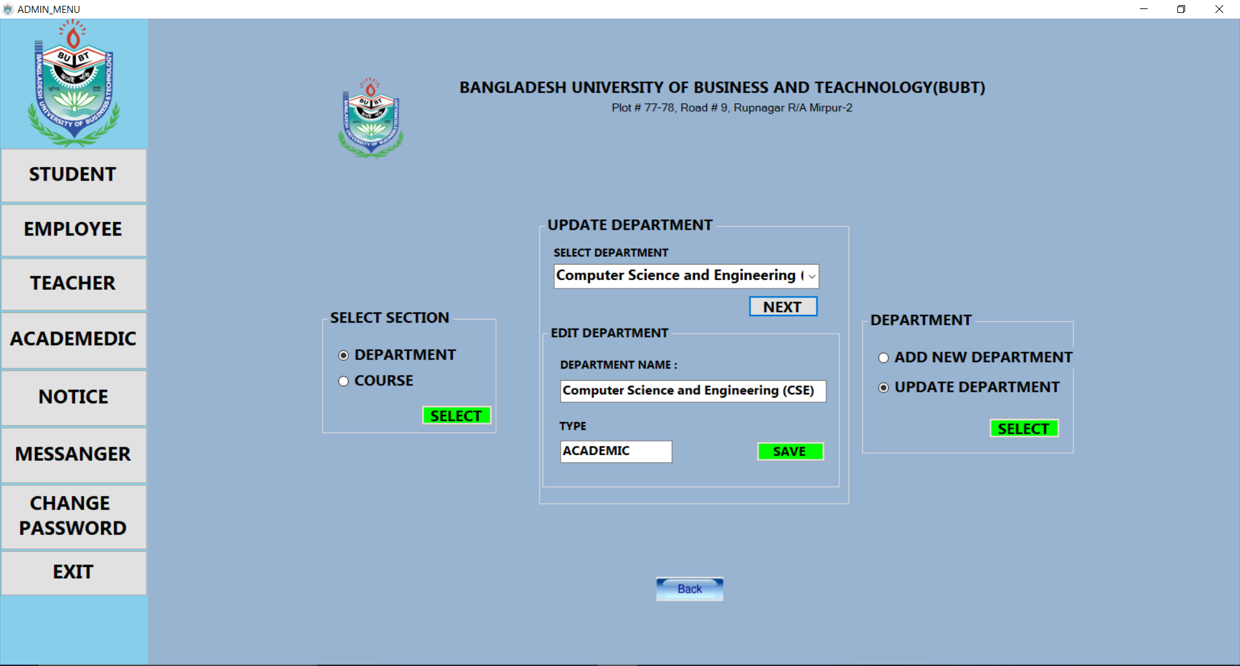
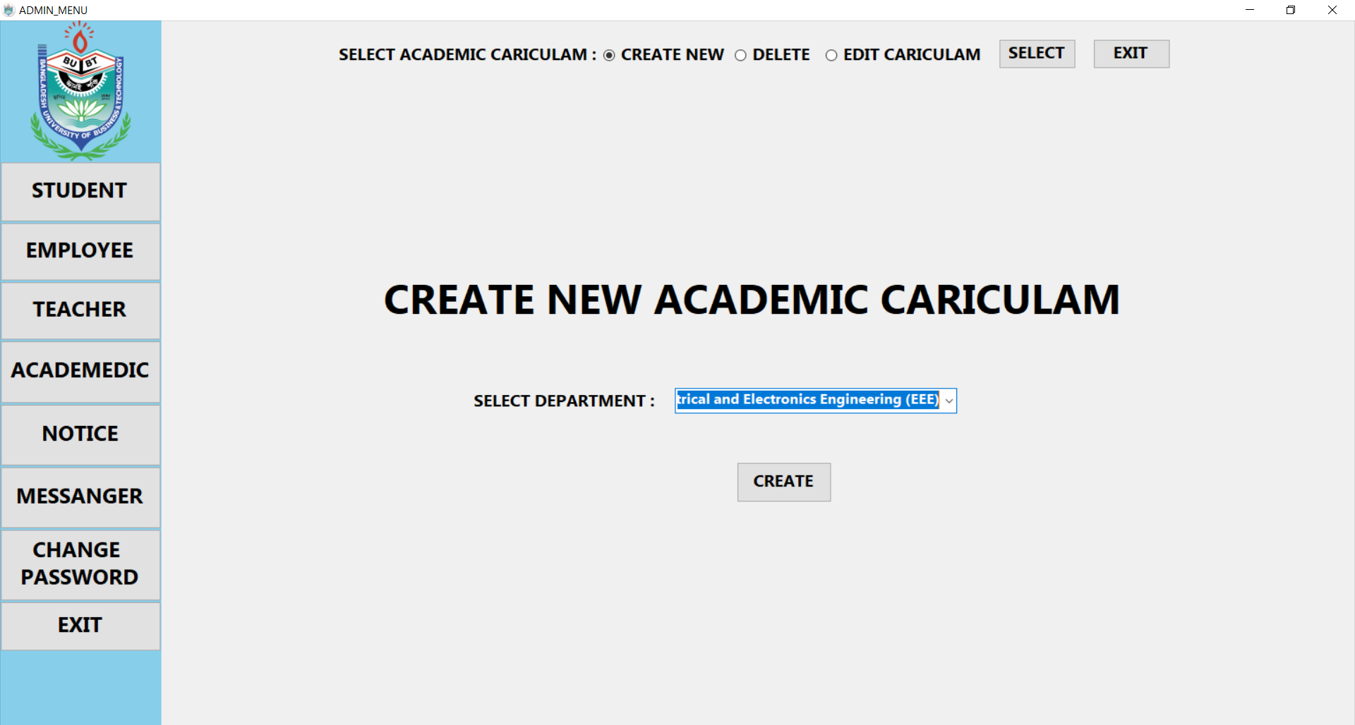
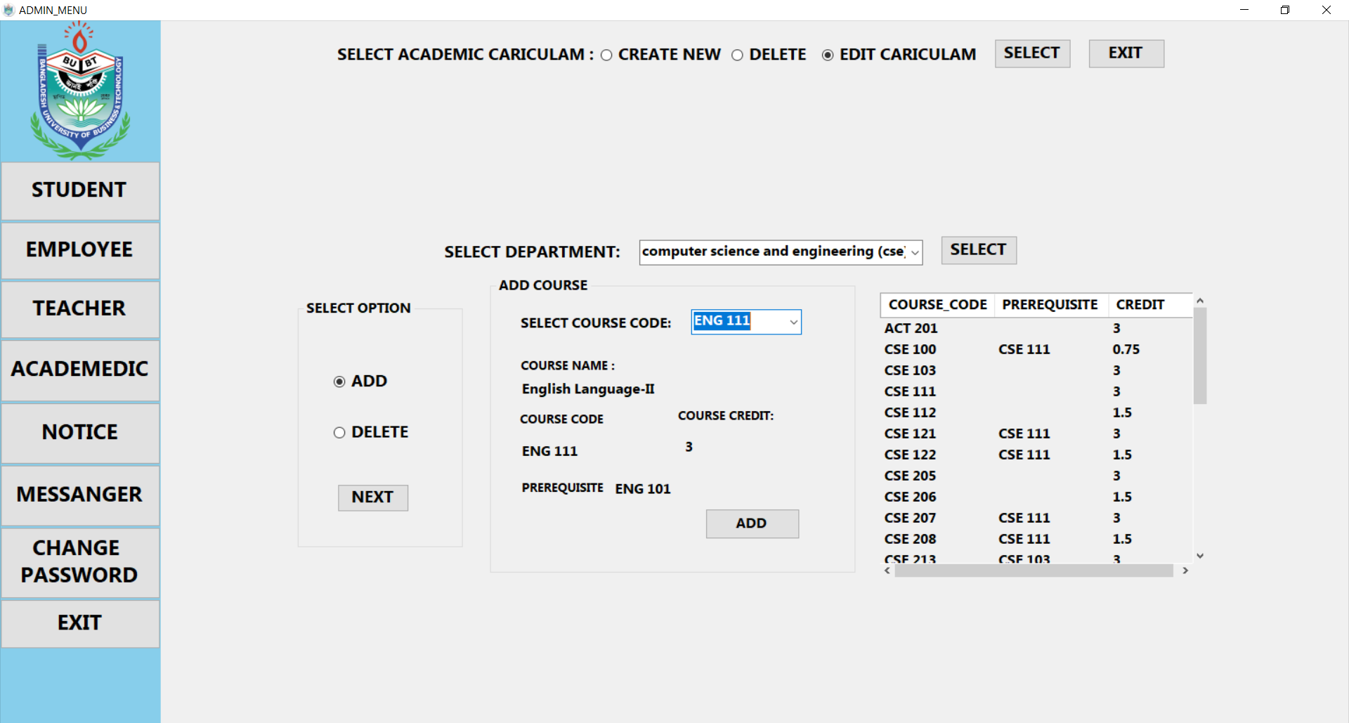
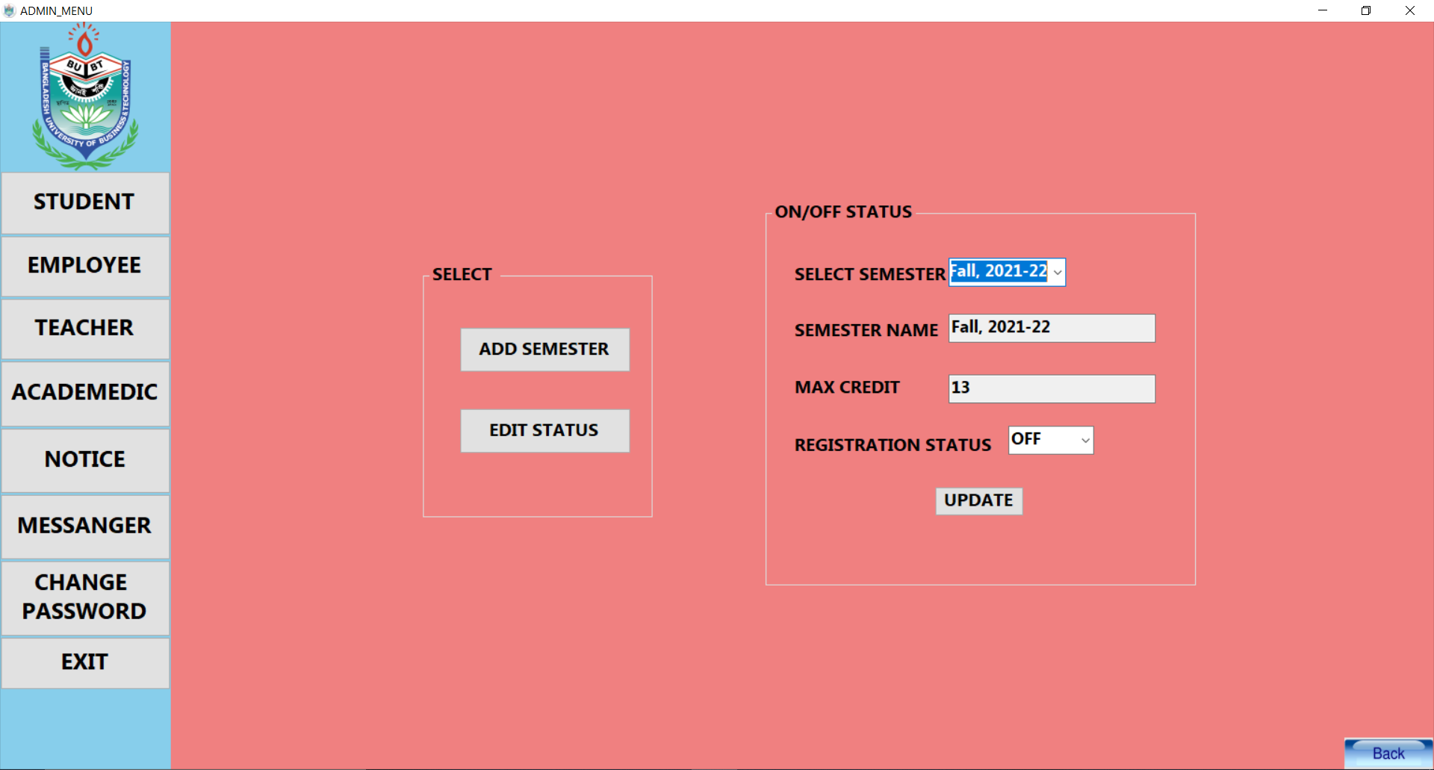
ADMIN-academic overview
ALL DEPARTMENT
ADD DEPARTMENT
EDIT DEPARTMENT
CREATE/DELETE CARICULAM
EDIT CARICULAM
ADD-EDIT
SEMESTER
18

Slide 19
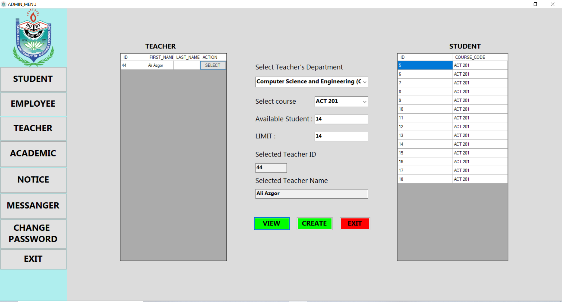
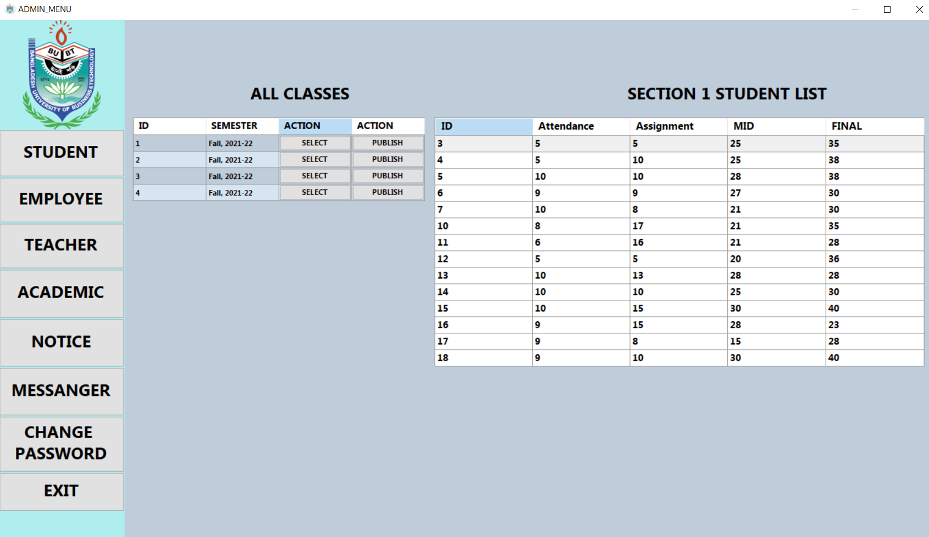
ADMIN-academic overview
CREATE SECTION
PUBLISH RESULT
19

Slide 20
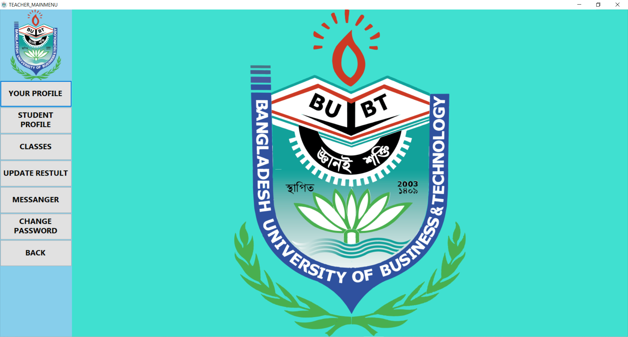
TEACHER
SEE INFORMATION
SEE STUDENT RE
-SULT
SEE STUDENT INF
-ORMATIOM
UPDATE STUDENT
RESULT
MESSENGER
CLASSES
CHANGE PASSWO
-RD
20

Slide 21
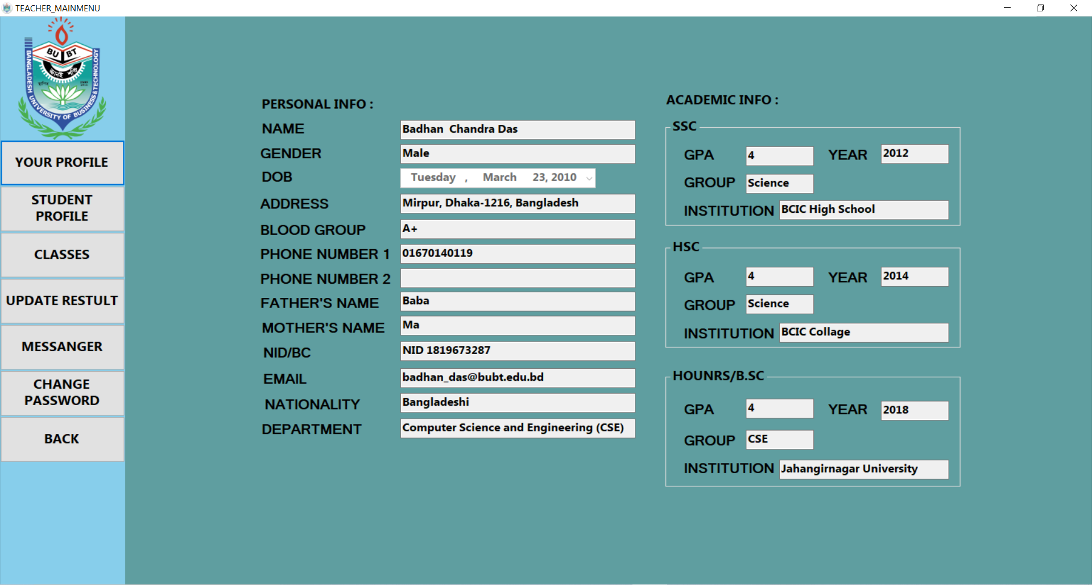
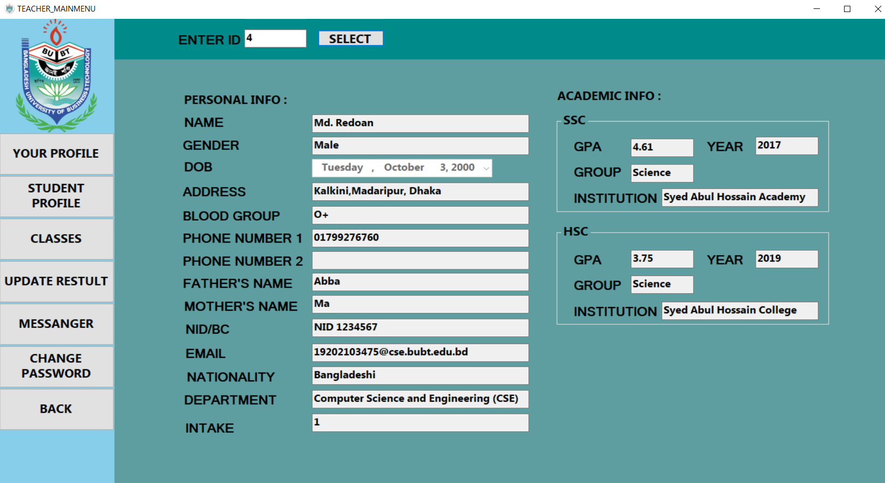
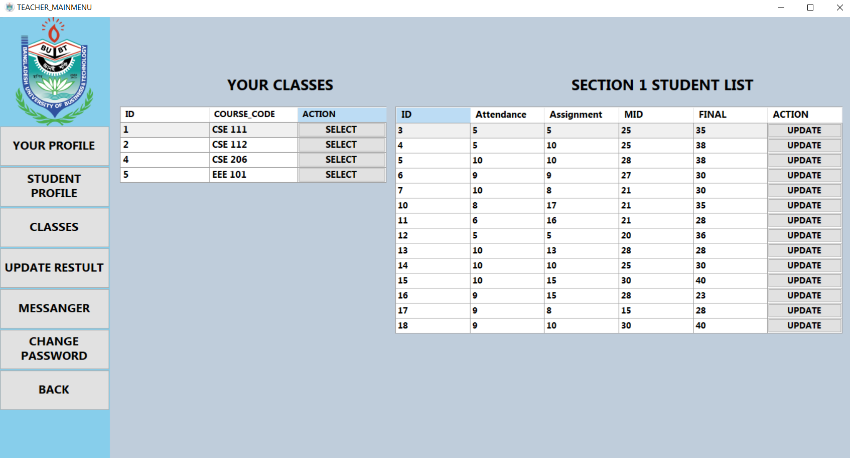
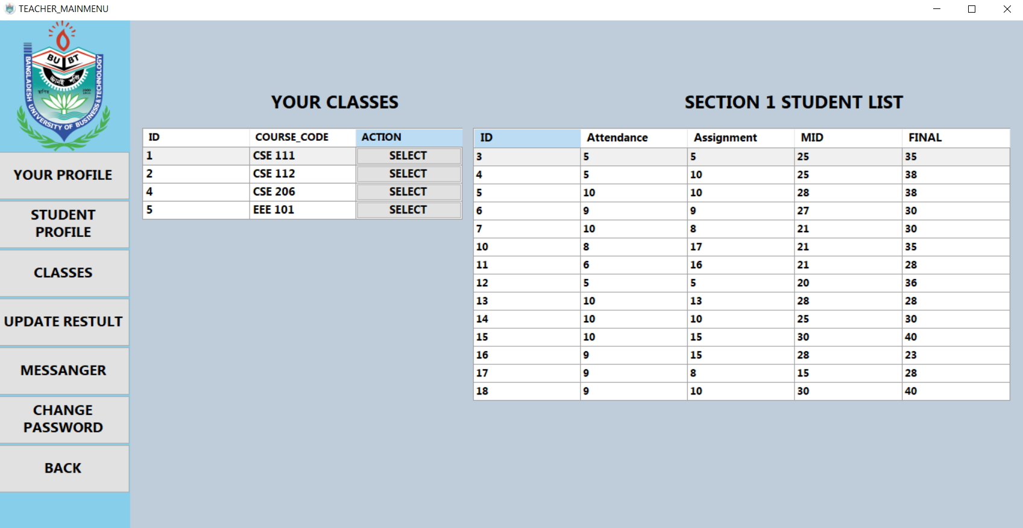
TEACHER overview
INFORMATION
STUDENT INFO
UPDATE RESULT
SEE CLASSES
21

Slide 22
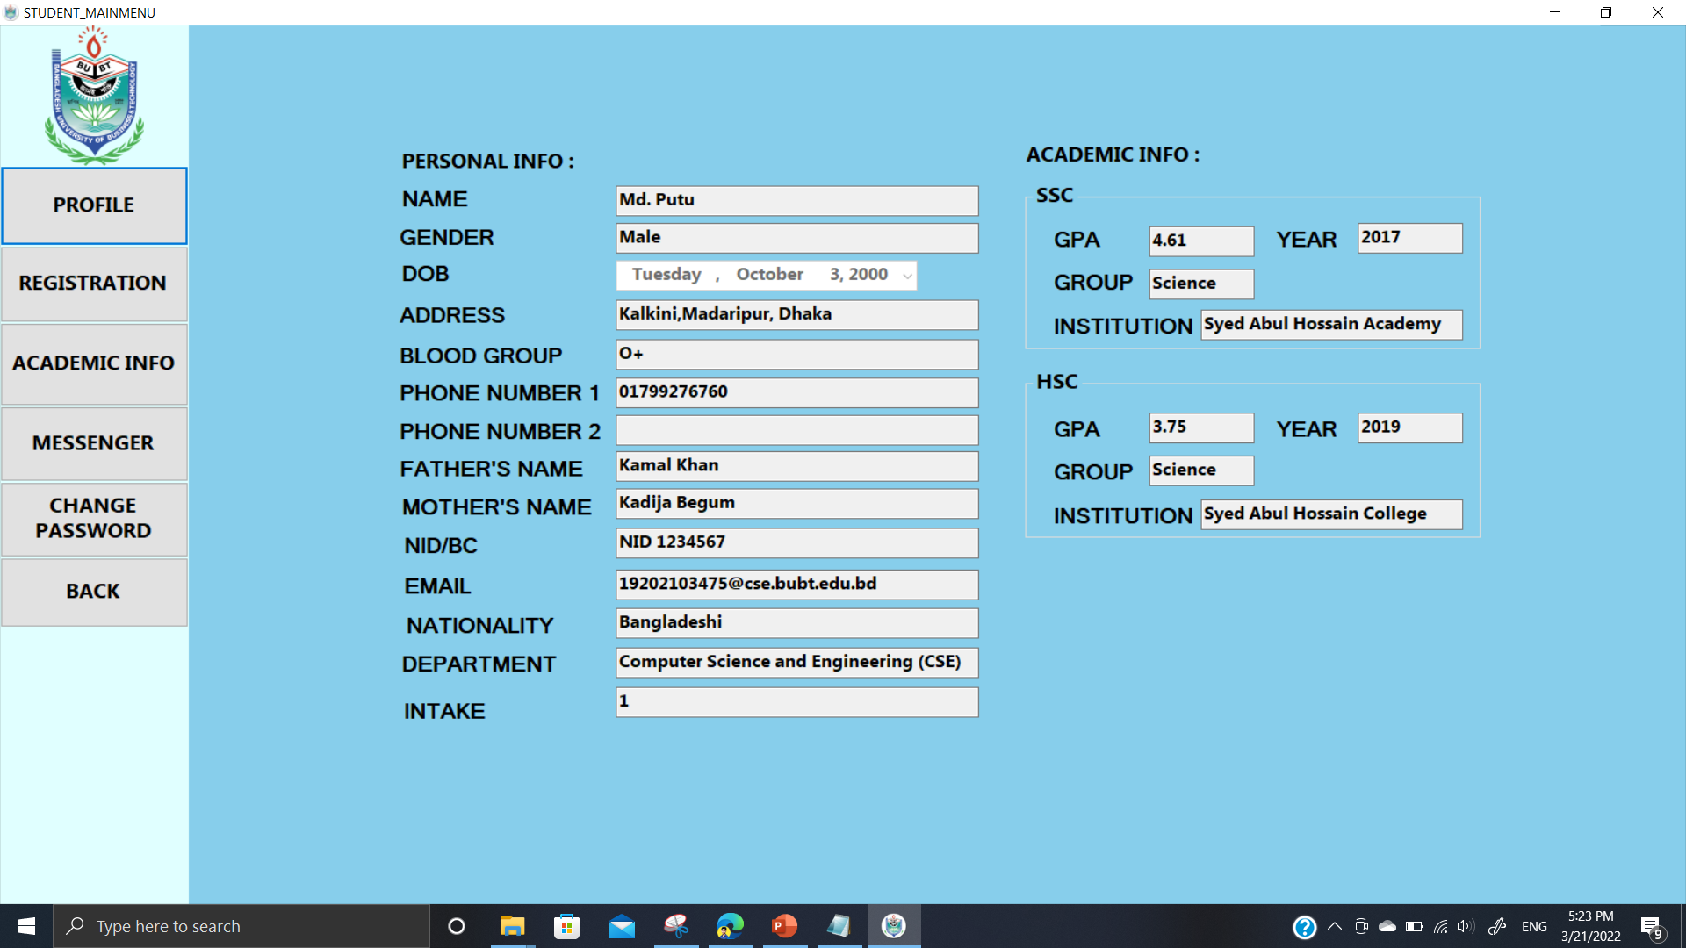
STUDENT
SEE INFORMATION
SEE PRESENT COU
-RSE
COURSE REGISTR
-ATION
SEE RESULT
MESSENGER
CHANGE PASSWO
-RD
22

Slide 23
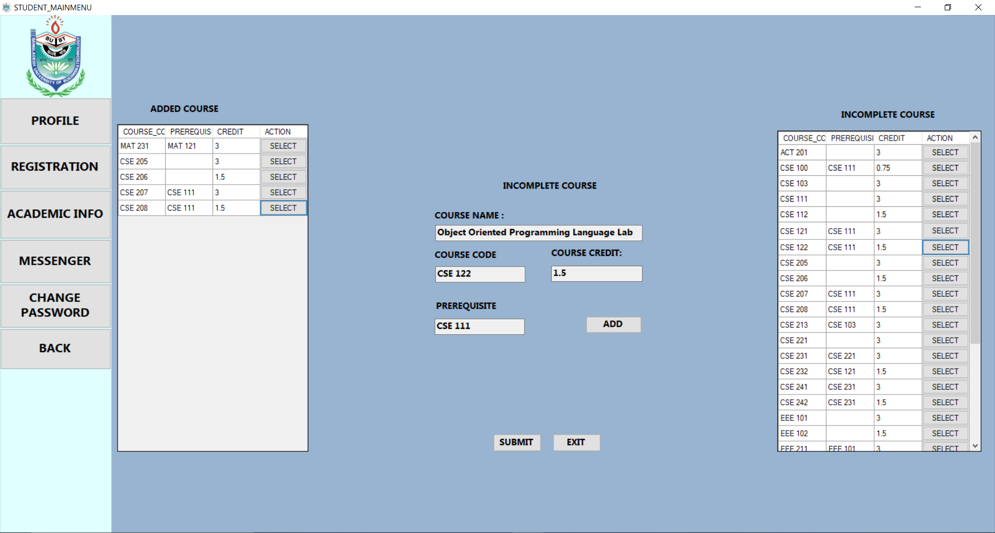
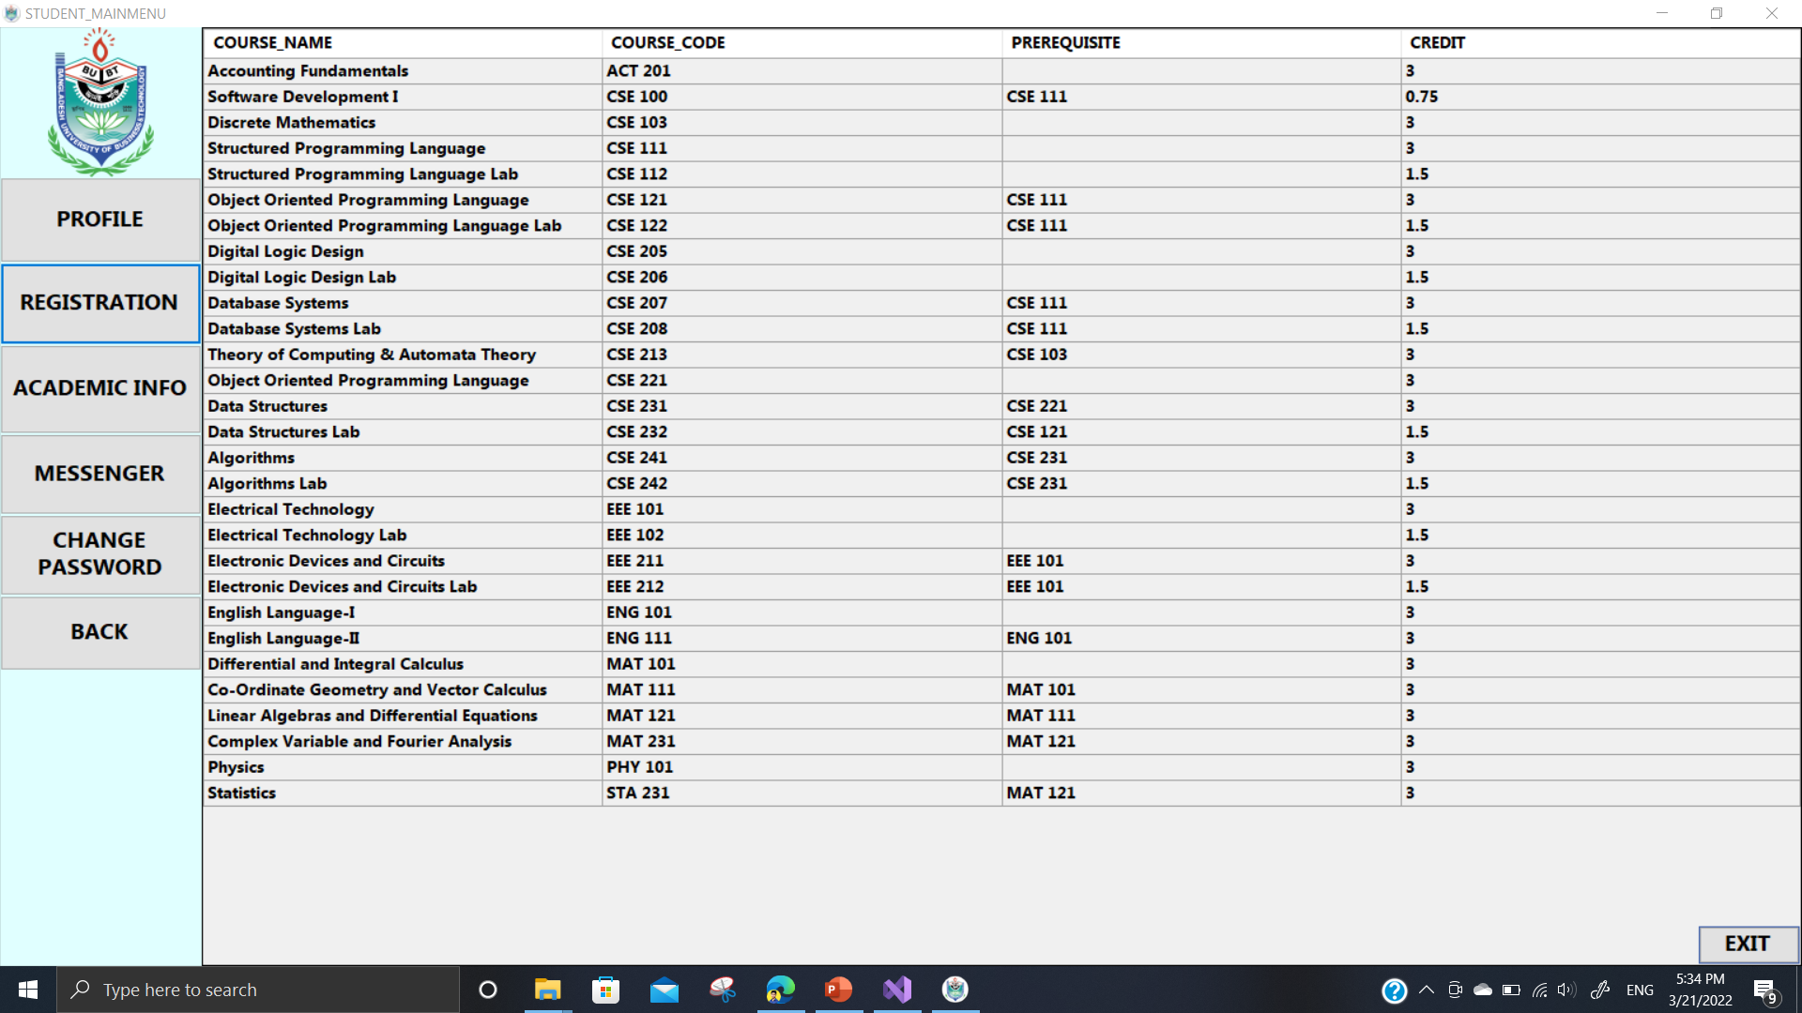
STUDENT-ACADEMIC overview
COURSE REGISTRATION
ALL COURSE
RESULT

Slide 24
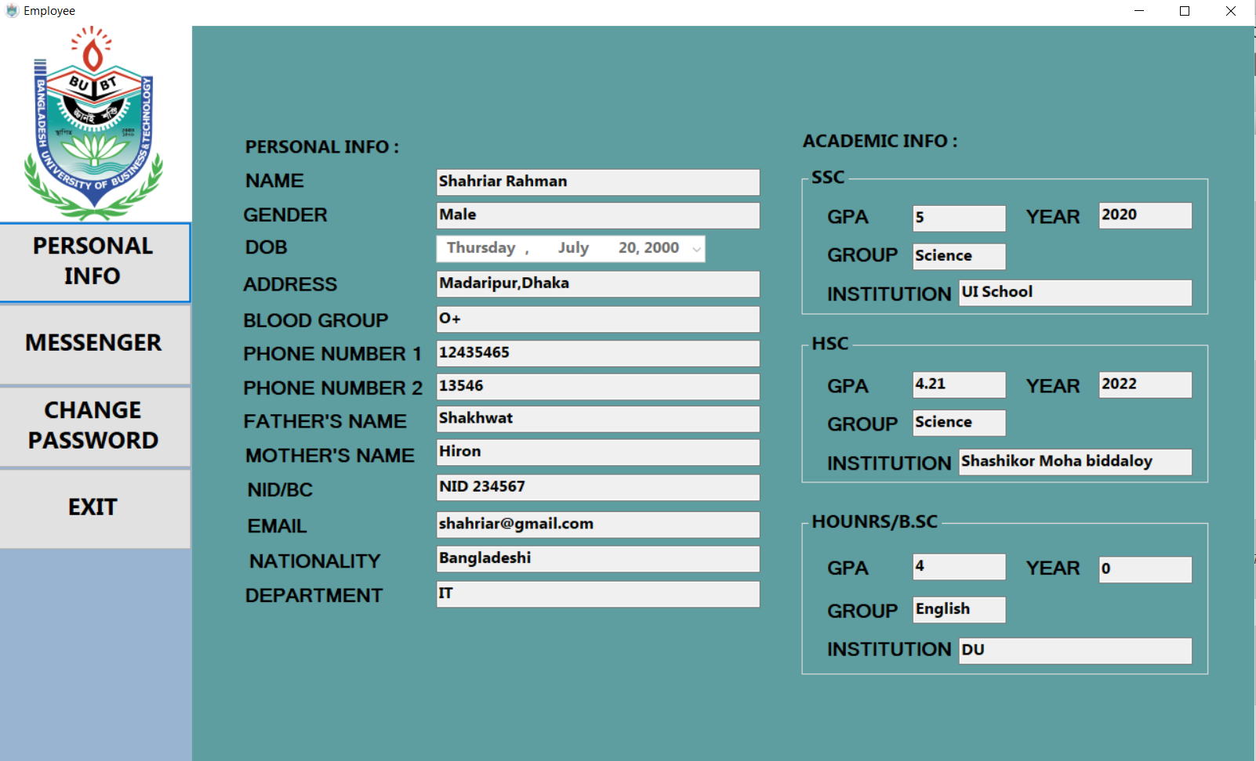
employee
SEE PROFILE
INFORMATION
24

Slide 25
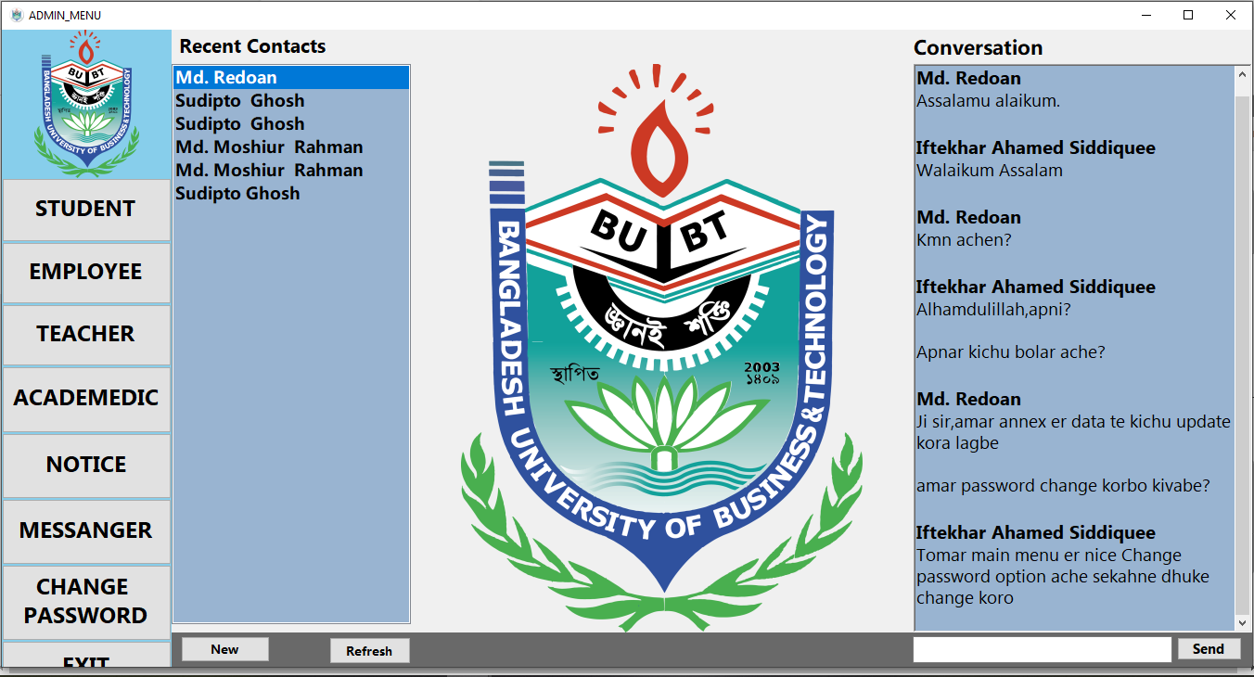
MESSENGER
MESSENGER
25

Slide 26
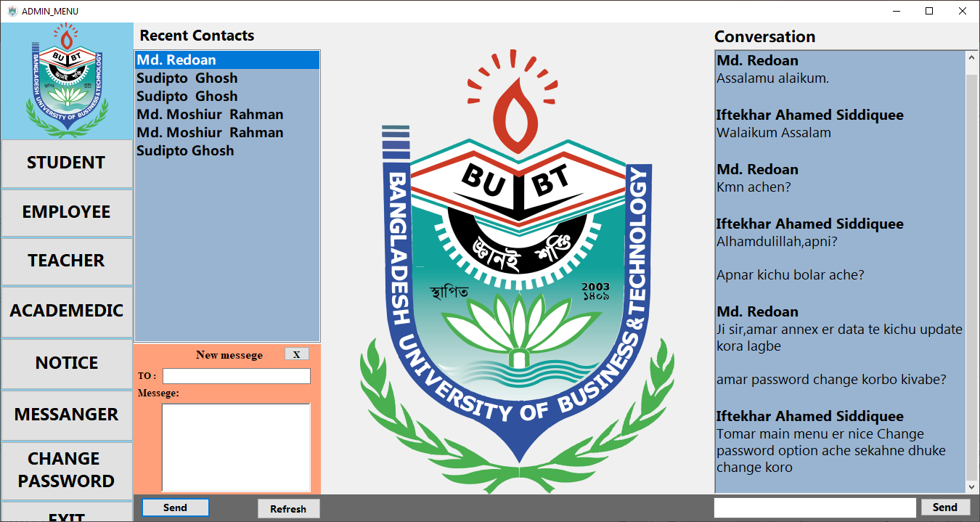
MESSENGER-Send message
SEND MESSAGE
26

Slide 27
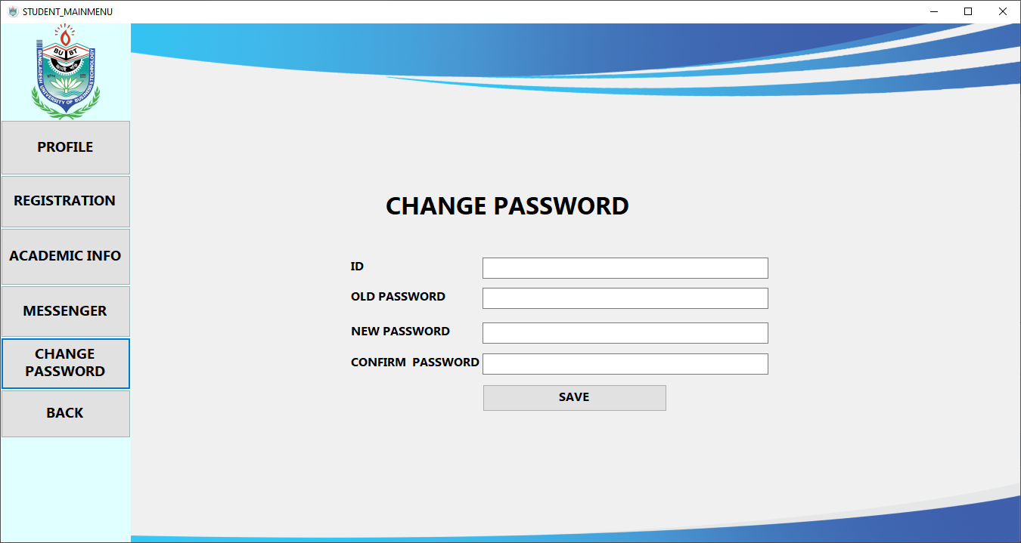
CHANGE PASSWORD
CHANGE PASSWORD
27

Slide 28
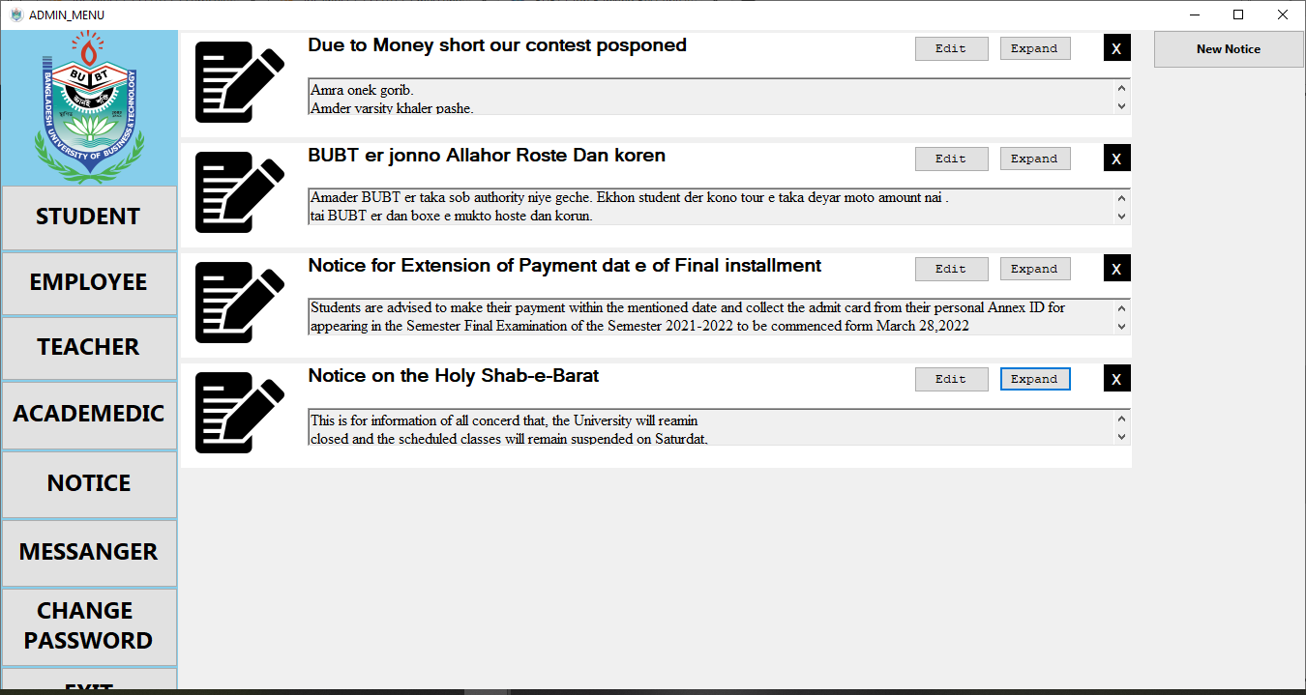
NOTICE BOARD
SEE NOTICE
28

Slide 29

Future plan
Web-based.
Encryption Method.
User interface.
Accounts Section.
Library Section.
29

Slide 30
Conclusion
Helpful approach for the users
Reduces the time
User friendly approach.
Maintains communications between
student and teachers.
30

Slide 31

THANKS!
31

